Slide 1
Machine Learning Project
Yahoo Troll Question Detection
Team Name: Kuch_toh_karunga
IMT2020062 Samarth Gattu Presentation-1 22-10-2022 (slide 2)
IMT2020054 Chaithanya Reddy Presentation-2 22-11-2022 (slide 3)

Slide 2
Presentation-1
Date: 22-10-2022

Slide 3
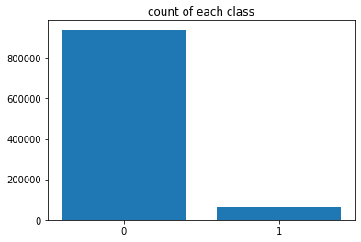
Data Analysis
Data contains letters, numbers, punctuation marks and special characters.
Data also contains few words of different languages.
It contains html tags and URLs.
Contains both uppercase and lowercase letters.
Sentences contain contractions.
Bias in target value: Most of the target values are ‘0’.

Slide 4
Preprocessing
Remove URL
Remove all special characters
Expand contractions
Change all the letters to lowercase
Tokenized the sentences.
Remove stop words.
Lemmatization

Slide 5
Preprocessing
Vectorizers
Used Count-vectorizer and TF-IDF (term frequency - inverse document frequency) to vectorize the dataset.
Tried different values of maxfeatures and ngrams.
ngram(1,2) and ngram(1,3) gave best f1_score.

Slide 6
Over Sampling
The given dataset has bias in the target value. Number of 0’s is more than 10x the number of 1’s in the dataset.
To increase the priority to the minor class we used random over sampler which can either be used to increase the minority class data points or decrease the majority class data points.

Slide 7
Training Models Used:
Logistic Regression
Perceptron
XGBoost
Ridge Classifier
For each of the above models we have tried both Count vectorization and tf-idf vectorization.
SVM and Adaboost: Taking a lot of time for training.

Slide 8
Training Models Used:
Logistic Regression
Tried different number of iterations to find best f1_score for the prediction.
Gave the best f1_score out of all the models we tried.
Perceptron, XGBoost, Ridge Classifier
Gave similar f1_score, but Logistic regression gave a higher f1_score compared to them.

Slide 9
f1_scores
Model | Count-Vectorizer | Tf-Idf
Logistic Regression | 0.5892587486048191 | 0.5237924682767089
Perceptron | 0.49960274804879184 | 0.46995762928173973
Ridge Classifier | 0.5182186234817814 | 0.558688819039066
Xg-Boost | 0.5020454545454546 | 0.5006962007331419

Slide 10
Presentation - 2
Date: 22-11-2022

Slide 11
Preprocessing
Done all the preprocessing steps done during last submission (remove URL, remove all special characters, expand contractions, change all letters to lowercase, Tokenized the sentences, remove stop words)
Added parts of speech to the words for lemmatization.
There are some sentences which have multiple languages:
We tried translating all language words to english (this process showed estimate time 15hr)
We removed stop words in majorly used languages (english, french, spanish, german, etc)
We took a new feature “Profanity” of sentences.
There are few spelling mistakes in sentences ,we removed all the errors.

Slide 12
Oversampling and Undersampling
Previously we tried Over-sampling.
Now we tried Under-sampling (decreased the rows of majority class).
Both of them gave similar results (but over-sampling gave better f1_score).
Tried different ngram_range [ unigram (1,1), bigram(1,2), trigram(1,3) ,etc].
bigram (1,2) gave betterf1_score

Slide 13
Results and Observations
OVERFITTING - Oversampling and Undersampling were giving very high f1_score on training data (more than 90%) but gave 58-62% f1_score on test_data.
Even after many preprocessing steps, f1_score wasn’t increasing.
We removed all the pre-processing steps (except count vectorization) and obtained a very high f1_score.

Slide 14
Training models used
We tried multiple training models (XGBoost, Ridge Classifier, Logistic Regression, KNN model, etc)
Logistic was giving very high f1_score compared to other models.
So, we tried Logistic regression with many variations (class_weights, solver, max_iterations, etc).
Class_weights boosted the f1_score significantly.
Tried different combinations of Class_weights.
Class_weights = {0.85 for minority class and 0.15 for majority class} and bigram(1,2) gave best f1_score.

Slide 15
Results - f1_score on (kaggle)
Logistic Regression | Count-Vectorizer
With preprocessing, multiple ML models with default parameters (logistic regression, ridge regression, perceptron, xgboost) | Best - 0.60158 (logistic regression)
With preprocessing (including sampling), ngram_range(1,3), classweights(0.15,0.85) | 0.61122
Without preprocessing (only countvectorizer), ngram_range(1,2), classweights(0.15,0.85) | 0.64395 (BEST)
Without preprocessing (only countvectorizer), ngram_range(1,2), classweights(0.10,0.90) | 0.63813
Without preprocessing (only countvectorizer), ngram_range(1,2), balanced weights | 0.60623

Slide 16
What next?
In next iteration we will try Neural Network models.
We will try using combination of multiple ML models.

Slide 17
Presentation - 3
Date: 17-12-2022

Slide 18
Preprocessing
Done all the preprocessing steps done during last submission (remove URL, remove all special characters, expand contractions, change all letters to lowercase, Tokenized the sentences, remove stop words)
Added parts of speech to the words for lemmatization.
There are some sentences which have multiple languages:
Translation
Remove stop words of multiple languages.
Profanity
There are few spelling mistakes in sentences, we removed all the errors.
Oversampling/Undersampling

Slide 19
Results
( All preprocessing steps and oversampling are applied, with default parameters of the model )
Model | Count-Vectorizer | Tf-Idf
Logistic Regression | 0.5892587486048191 | 0.5237924682767089
Perceptron | 0.49960274804879184 | 0.46995762928173973
Ridge Classifier | 0.5182186234817814 | 0.558688819039066
Xg-Boost | 0.5020454545454546 | 0.5006962007331419

Slide 20
Preprocessing Observations
All these steps didn’t improve the f1_score significantly.
OVERFITTING:
Oversampling and Undersampling were giving very high f1_score on training data (more than 90%) but gave 58-62% f1_score on test_data.
Removed all Pre-Processing steps. Great improvement in f1_score.

Slide 21
Logistic Regression
Countvectorizer ngram(1,2), (1,3)... (1,5)
balanced_weights
class_weights
predict
predict_proba

Slide 22
Results - f1_score on (kaggle)
Logistic Regression | Count-Vectorizer
With preprocessing, multiple ML models with default parameters (logistic regression, ridge regression, perceptron, xgboost) | Best - 0.60158 (logistic regression)
With preprocessing (including sampling), ngram_range(1,3), classweights(0.15,0.85) | 0.61122
Without preprocessing (only countvectorizer), ngram_range(1,2), classweights(0.15,0.85) | 0.64395 (BEST)
Without preprocessing (only countvectorizer), ngram_range(1,2), classweights(0.10,0.90) | 0.63813
Without preprocessing (only countvectorizer), ngram_range(1,2), balanced weights | 0.60623

Slide 23
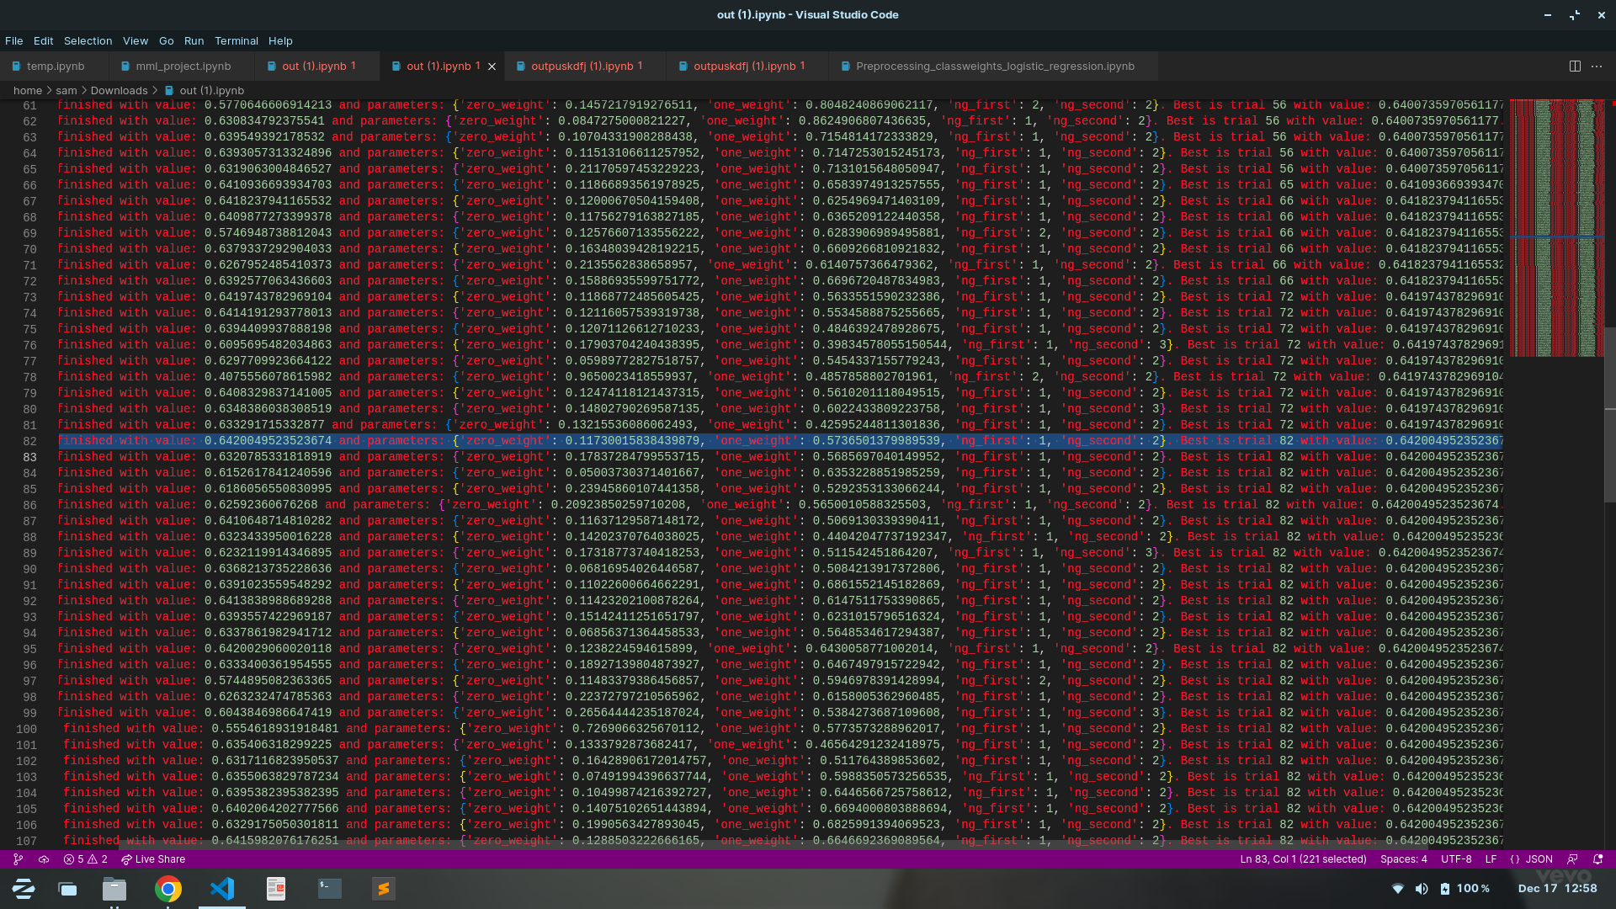
Hyper parameter tuning
Logistic Regression - ngram(1,2)-ngram(1,5), countvectorizer
Hyper parameter tuning on class weights.

Slide 24
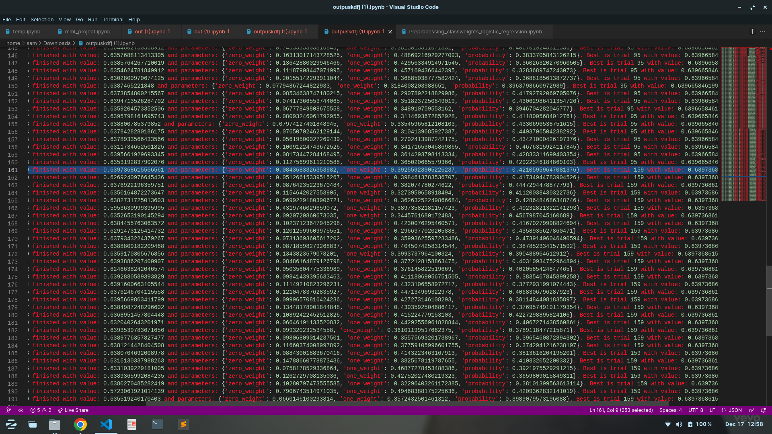
Hyper parameter tuning
Logistic Regression - ngram(1,3), countvectorizer
Hyper parameter tuning on class weights and predict_proba.

Slide 25
Results - f1_score on (kaggle)
Logistic Regression ngram(1,3) | f1_score
With preprocessing (including sampling), ngram_range(1,3), classweights(0.15,0.85) | 0.61122
classweights(0.117,0.753) predict_proba(>0.63) [ without preprocessing ] | 0.62797
classweights(0.117,0.753) predict_proba(>0.45) [ without preprocessing ] | 0.64861
classweights(0.117,0.685) predict_proba(>0.425) [ without preprocessing ] | 0.64902 (BEST)

Slide 26
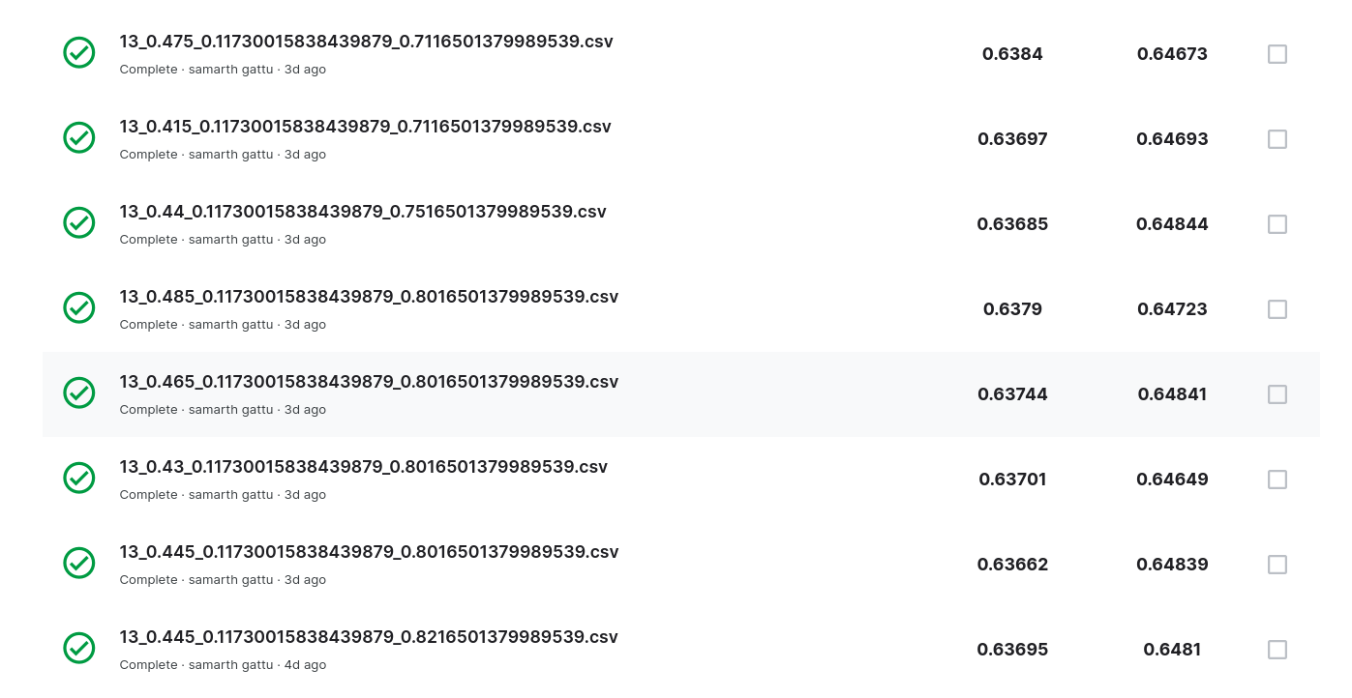
Results

